Slide 1
Sine Ratio
Miss L
Year 12 Essentials

Slide 2
Learning Intentions
Students will be able to
Find the unknown sides and angles using the Sine Ratio

Slide 3
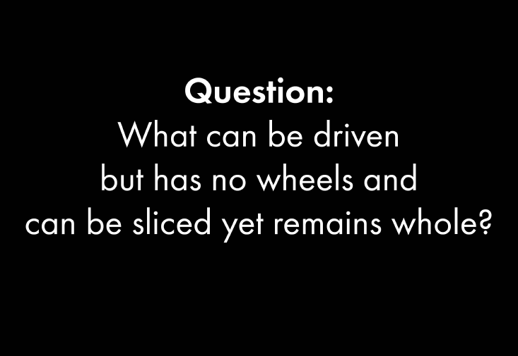

Slide 4
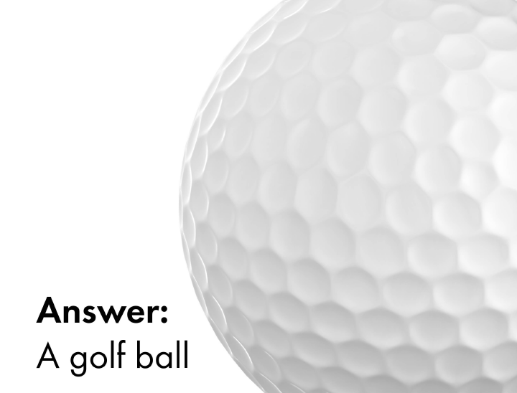

Slide 5
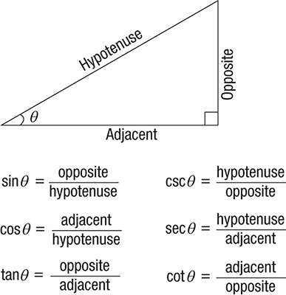
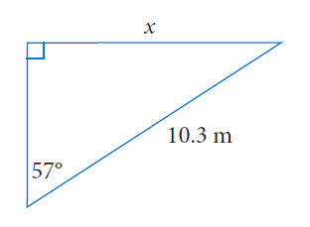
Trigonometry Functions
If we are given the hypotenuse and the opposite side we use the Sine Ratio

Slide 6
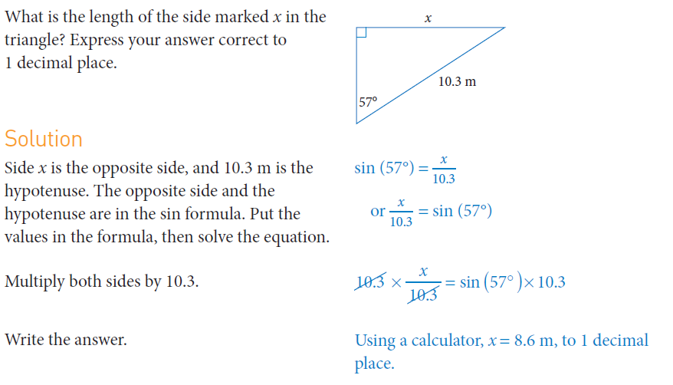
24
7
30
Trigonometry
Date
EQ – How do we use the Sine Ratio to find sides and angles?

Slide 7
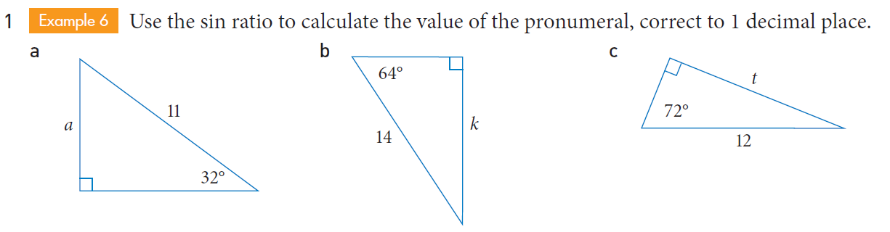
Practice
Get the person next to you to mark your work, be prepared to share your answers

Slide 8


Slide 9
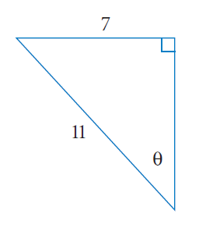
24
7
30
Trigonometry
Date
EQ – How do we use the Sine Ratio to find sides and angles?
Sinϴ = Opposite
Hypotenuse
Sinϴ = 7
11
Sinϴ = 0.636
ϴ = Sin ⁻¹ (0.636)
ϴ = 39.49° (degrees)

Slide 10
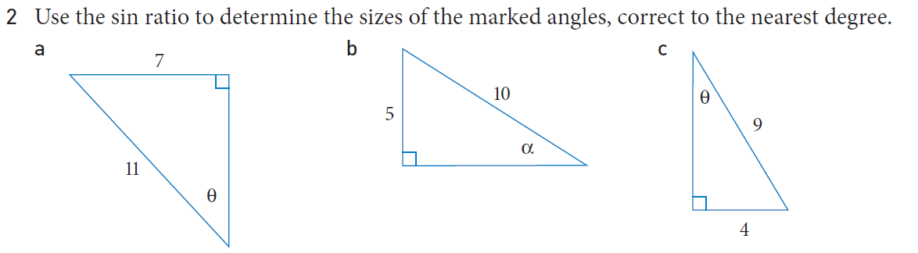
Practice
Get the person next to you to mark your work, be prepared to share your answers

Slide 11
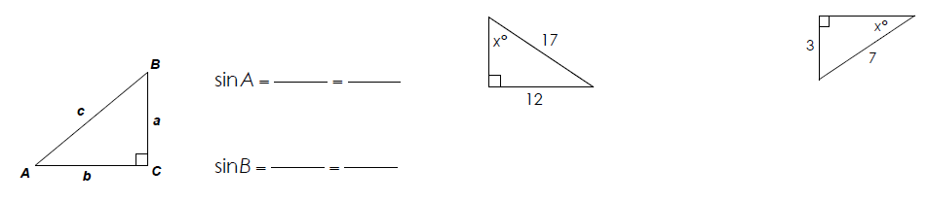
Task
Complete the worksheet
We will go through the answers together after
Complete Exit Pass – Fill in the Sine Section of your foldable

Slide 12
